Slide 1
Diversity of Appearance
Chhavi Kapoor and Cynthia Ades

Slide 2
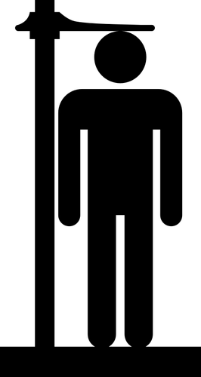
What We Didn't Know
The issue of appearance bias has been recognized since the late 1970's
Michigan became the first state to explicitly prohibit discrimination based on weight and height and it is still illegal in 49 states
Diversity of appearance involves multiple dimensions of diversity
Never knew Heightism existed
Corporate look policies are legal unless employment decisions based on appearance are directly related to an employment right of an employee protected by EEOC regulated or state/local laws
*developed by Chhavi & Cynthia

Slide 3
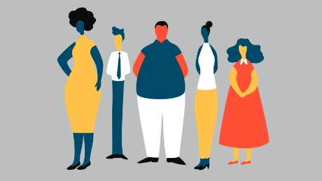
Diversity of Appearance includes and is not limited to:
Height
Weight
Beauty-Attractive vs Unattractive
Wearing of Religious Articles
Visible Disabilities
Hair style
Tattoos
Body Piercings

Slide 4
What Shouldn't Be Missed
Aimee Stephens was fired from her job after informing her boss that she was having sex reassignment surgery and would be returning to work following the dress code for women. Ms. Stephens was fired for her clothing choice.
The beauty bias that exists, especially for women, is very harsh. Being physically attractive is beneficial because you may be chosen over your peers and get paid more. For women, it benefits them for “feminine” jobs, but when applying for “masculine” jobs, such as managerial positions, being physically attractive as a woman is a disadvantage.
49 states allow employers to discriminate based on height and weight
Up until December 2019, it was legal to discriminate based on natural hair styles, such as afros, locks, and braids
Appearance can affect one being selected for a job opportunity or receiving a promotion
The vast number number of advocacy groups that exist to support the discrimination of all the different features of the diversity of appearance

Slide 5
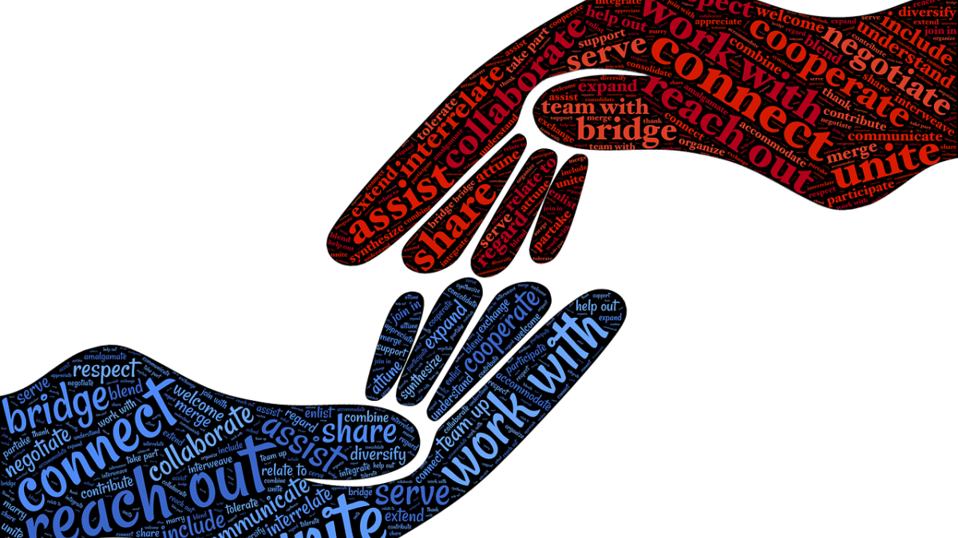
Section I
Social Justice Issues

Slide 6
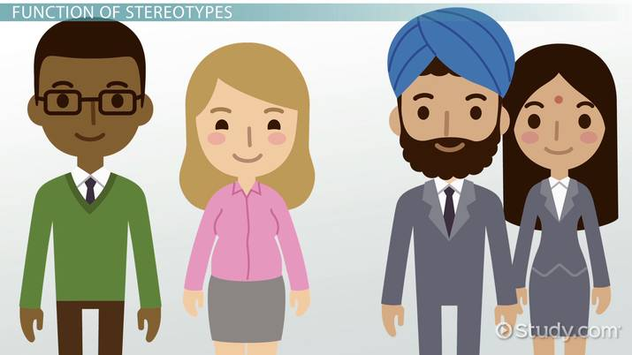
Societal Stereotypes
“All men that wear Sikh turbans are terrorists”
Obese people are “Lazy, unmotivated, lacking in self-discipline, less competent, non-compliant and sloppy”
“Physically attractive people are more likely to succeed, friendlier, honest & competent”
“Natural hairstyles are unprofessional, messy, not neat, political, radical, too eye-catching, or excessive”
Notes:
The first stereotype is something that has been a growing stereotype especially since 9/11. Sikh individuals who wear turbans are constantly stereotyped as “terrorists”, which is ofcourse a huge myth. A man wearing a turban can be less respected and included in the workplace than a man who may be wearing a cross around his neck, even though both instances have to do with religion. Ofcourse, it is a myth to associate every man with a turban with a terrorist (Pasha-Zaidi 2015).
One’s physical appearance can come with negative stereotypes and employment discrimination. Obese individuals may be judged off their looks and determined to be lazy, unmotivated, sloppy, etc. just because of their weight, when their weight does not determine any of that. Obesity does not correlate with any of those characteristics, as a thinner individual can portray those characteristics too. It is actually legal in 49 states to terminate a person for being overweight. Anti Discrimination laws do not provide enough protection for overweight employees even though weight discrimination is common. A 2008 Yale study found that 10% of women and 5% of men experienced weight discrimination and a 2014 Vanderbilt University study found that overweight women are paid less than their male colleagues. (Martin 2017)
“Lookism” refers to the concept that attractive employees and job candidates are hired more often than their less attractive peers. Physical appearance does not determine how successful someone may turn out to be, but people are still often judged by their physical appearance (Toledano 2013).
For a long time, people of color have had to deal with employers turning them away or forcing them to “groom” their hair because natural hairstyles seems unprofessional. Natural hairstyles are not unprofessional or messy because it is natural. People of color have been forced to conform their hair to Eurocentric beauty standards, which is not fair. As a result of the “natural hair movement” black women have formed a new positive relationship with their hair, so employers and laws need to catch up as well (Gandy 2017).

Slide 7
Exclusion, Discrimination, & Inequities Overview
Black women have faced being called unprofessional and unpresentable for sporting their natural hairstyles
Men and women are excluded in the workplace because of religious articles of clothing including the Hijab and Turbans
Beauty biases can be beneficial and harmful to individuals
“What is beautiful is good” suggests that physically attractive people benefit from their beauty
“Beauty is beastly” suggests that physical attractiveness can be detrimental to women, especially when applying for “masculine” jobs
Notes:
Lookism: “where attractive employees and job candidates are hired more often than their less attractive peers, more readily promoted, and paid more over their lifetimes” (Toledano 2013). Basically, lookism goes against something important we were taught in elementary school, “don’t judge a book by its cover”, while lookism is doing exactly that.
The EEOC was created as a result of the Civil Rights Act of 1964, which ended segregation in public places and banned employment discrimination. The first natural hair discrimination case appeared in 1976, Jenkins v. Blue Cross Mutual Hospital Insurance. The appeals court agreed that workers were allowed to wear their natural afros under Title VII of the Civil Rights Act (Griffin 2019).
According to the concept overview for this section, a man wearing a turban may be less heard, respected, supported, invited to be a part of what is important in the organization than someone who may be wearing a cross around their neck. Both are displays of religion, but the turban comes with many more negative stereotypes. In some instances, this results in covering in fear of being excluded in the workplace. As David Scher said, preventing employees from wearing a turban can constitute religious discrimination. Even though someone may not be told to remove their turban or hijab because it is discrimination, they will still face exclusion in the workplace.
Attractive applicants are deemed to be more hirable and likeable than less attractive candidates. Physically attractive applicants are also offered higher starting salaries than their less attractive peers. Looking at earnings, a study of MBA graduates found that the earnings gap between attractive and unattractive employees widens over time. All this correlates with the “what is beautiful is good” bias. On the other hand, “beauty is beastly” bias effects attractive women trying to apply for masculine jobs. However, attractive men are always at an advantage over their less attractive peers. Attractive women are at an advantage when applying for feminine jobs, but are deemed not fit for masculine jobs, such as managerial positions. (Johnson et. al 2010) (Toledano 2013).

Slide 8
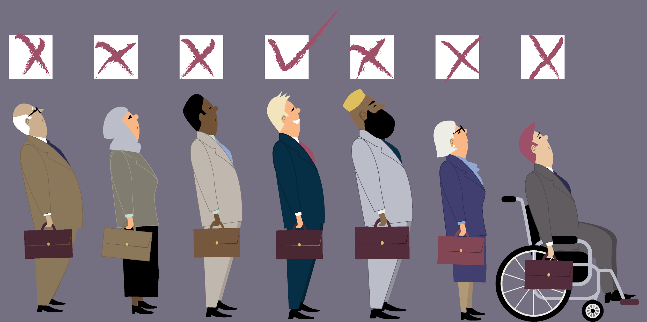
Exclusion, Discrimination, & Inequities Overview
Weight discrimination against overweight individuals
Heightism: prejudice against short people in relation to their taller counterparts
Individuals are discriminated based on their sexual orientation or gender identity
Notes:
Because of the lack of protection under law for overweight individuals, these employees are discriminated against in the workplace. A Yale University study found that 43% of overweight workers experienced weight bias from their supervisors, and more than half of the surveyed workers were harassed by colleagues. Heavier employees also earn less than their average-sized peers, will receive fewer raises, and are deemed to have low supervisory potential, all based on their weight. It seems so unfair to judge a person based on what you can see with your eyes, but lack of protection from laws makes it basically legal (New Eng. Law Rev. 2010).
“Gaze behavior” is a way of establishing social hierarchies on the basis of if we are looking up to or down on another individual. Ofcourse, looking down on someone is correlated with less social power and negative character traits. Those we look up get the “halo effect”, which is the automatic attribution of positive personality traits. Researches asked a group of recruiters to make a hiring decision between two equally qualified individuals, and 72% of the recruiters chose the taller candidate. Height also affects wages as every additional inch in height is correlated with a 1.8-2.2% increase in wages. In socially oriented jobs, such as a sales or management, height was predictive of earning. Moreover, height affects professional advancement because it impacts self-esteem and social esteem. It is not a coincidence that 58% of Fortune 500 CEOs are 6 feet or taller (Utah Law Review 2009).
Sexual orientation discrimination refers to harassment or discrimination based on someone's sexual orientation, such as being gay lesbian, bisexual, etc. Gender identity discrimination refers to harassment or discrimination based on someone’s actual or perceived gender identity. Individuals face being overlooked for promotions, wrongful terminations, or baseless write ups because of their sexual orientations or gender identity. Both these kinds of discrimination are violations of Title VII of the Civil Rights Act (Pantekoek 2020).

Slide 9
EEOC v. R.G. & G.R. Harris Funeral Homes Inc.
Ms. Aimee Stephens worked at a funeral home as an embalmer
In a letter, she informed her boss that she will be undergoing sex reassignment surgery and will “return to work as my true self, Aimee Australia Stephens, in appropriate business attire”.
Two weeks after receiving the letter, the owner, Thomas Rost, fired Ms. Stephens
When asked in court for the reason that Ms. Stephens was terminated, Rost said “because he was no longer going to represent himself as a man. He wanted to dress as a woman”.

Slide 10
EEOC v. R.G. & G.R. Harris Funeral Homes Inc.
Ms. Stephens filed a complaint with the EEOC, which sued the funeral homes for violating the Civil Rights Act of 1964, but a district court ruled in employers favor.
Ms. Stephens appealed the verdict and the 6th circuit court agreed that Title VII’s sex discrimination protection includes gender identity discrimination and that the funeral homes violated the law.
A month after Ms. Stephen’s death in May 2020, the U.S. Supreme COurt ruled 6-3 that federal law prohibits employment discrimination based on sexual orientation or gender identity. (Burke 2020) (Ortiz 2020)
Notes:
Unfortunately, after losing her job at the funeral home, Ms. stephens could not find another job, which caused her to lose her health insurance, and was unable to treat her kidney condition. It is sad that she did not live to see a big decision made in her favor, but it was all thanks to her for never giving up the fight. (Burke 2020) (Ortiz 2020)

Slide 11
Samantha Elauf v. Abercrombie & Fitch
Abercrombie & Fitch refused to hire Elauf because she wore a headscarf
Abercrombie’s refusal to accommodate to her religious practice was enough for Elauf to sue under a federal employment discrimination law
The vote was 8 to 1
Elauf had been awarded $20,000 by a jury, but the US Court of Appeals for the 10th circuit overturned the award, stating that the trial judge should have dismissed the case before trial
Title VII of the Civil Rights Act of 1964 prohibits religious discrimination in hiring
This case was a victory for the EEOC!
Notes:
Elauf is a muslim women who wears a hijab
Company said scarf clashed with their dress code
The company’s decision not to hire her was to avoid accommodating to her religious practice
Court of Appeals said the case should have been dismissed because Elauf never informed Abercrombie that she wore the headscarf for religious reasons

Slide 12
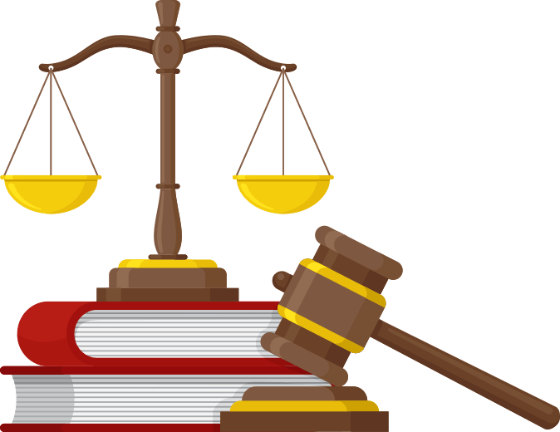
Section II: Legal Protections & Allies

Slide 13
Laws & Accepted Policies
New Jersey Law Against Discrimination (LAD)
Create a Respectful and Open Workplace for Natural Hair (CROWN) Act
New Jersey
California
New York
Virginia
Colorado
Washington
Cincinnati, Ohio
Montgomery County, Maryland
Notes:
LAD makes it illegal to discriminate based on someone’s race, creed, color, national origin, nationality, ancestry, age, sex (including pregnancy), familial status, marital status, religion, domestic partnership status, sexual orientation, gender identity, genetic information, and mental or physical disability.
In New Jersey, the CROWN Act became law in December 2019. This act amends the existing “Law Against Discrimination” and makes it illegal to target people at work, school, or in public on the basis of their hair texture, hair type, and protective hair styles such as braids, locks, and twists. Corporate America is known to be against natural hairstyles, so this act is a big win.
A first violation can result in a fine of $10,000. Maximum penalty for a second violation within 5 years is $25,000, and a third within 7 years could be a fine of $50,000.
There are CROWN Acts Laws in several states and municipalities

Slide 14
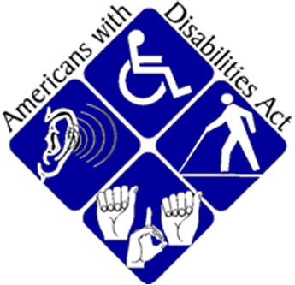
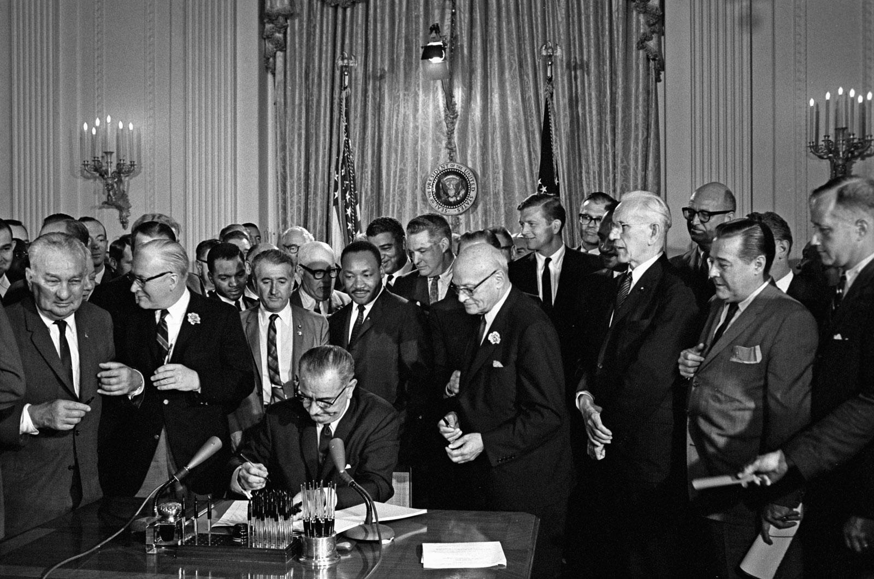
Laws & Accepted Policies
Michigan Law of 1976
District of Columbia, 949 A.2d 607, 615 (D.C. 2008)
Title VII of the Civil Rights Act of 1964
Religion policies
Americans with Disabilities Act (ADA)
Ordinances
Madison
Wisconsin
Urbana
Civil Rights Act of 1964
Notes:
Michigan is the only state that explicitly prohibits discrimination based on height AND weight. Many municipalities in California also offer the same protection.
District of Columbia offers blanket protection for all appearance based discrimination.
Title VII prohibits employment discrimination based on race, color, religion, sex, and national origin.
It is religious discrimination to ask someone to remove their turban or hijab in the workplace (Scher 2013).
Tattoos & Piercings: it is legal for employers to ask for them to be covered as long as the tattoos and piercings are not religious. (Sheets 2014).
The EEOC says obesity can be considered a disability and that discrimination based on obesity is not allowed under ADA.
Cities of Binghamton, San Francisco, and Santa Cruz prohibit discrimination based on weight.
The cities of Madison, Wisconsin, and Urbana, Illinois have ordinances that ban discrimination based on physical appearance and personal appearance.

Slide 15
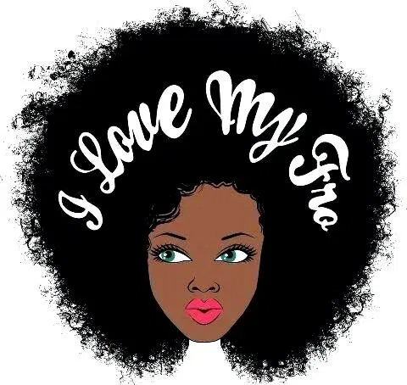

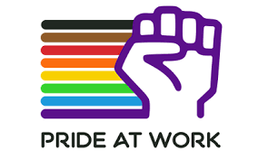

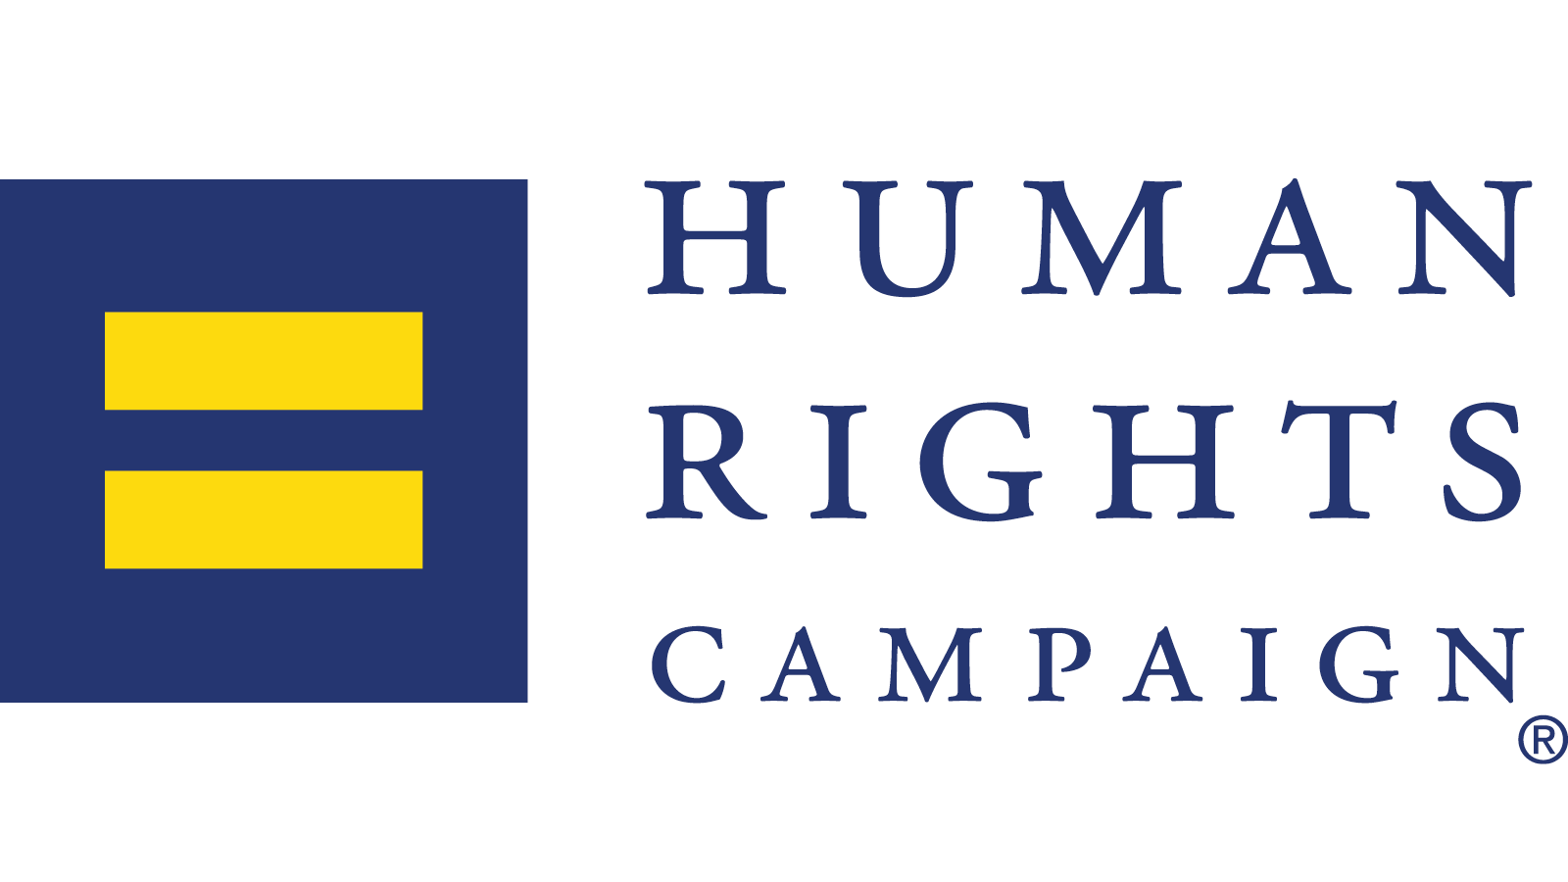

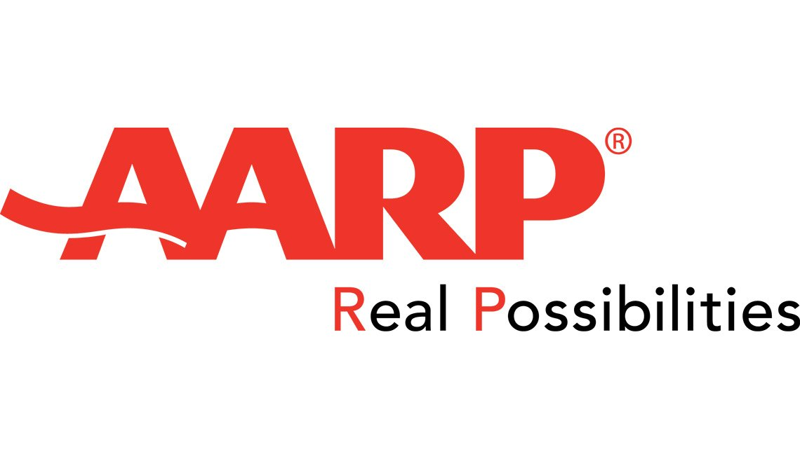

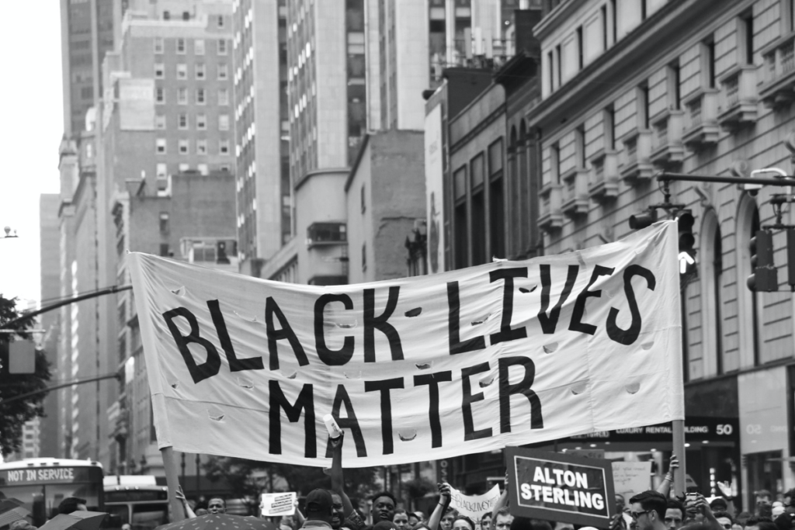
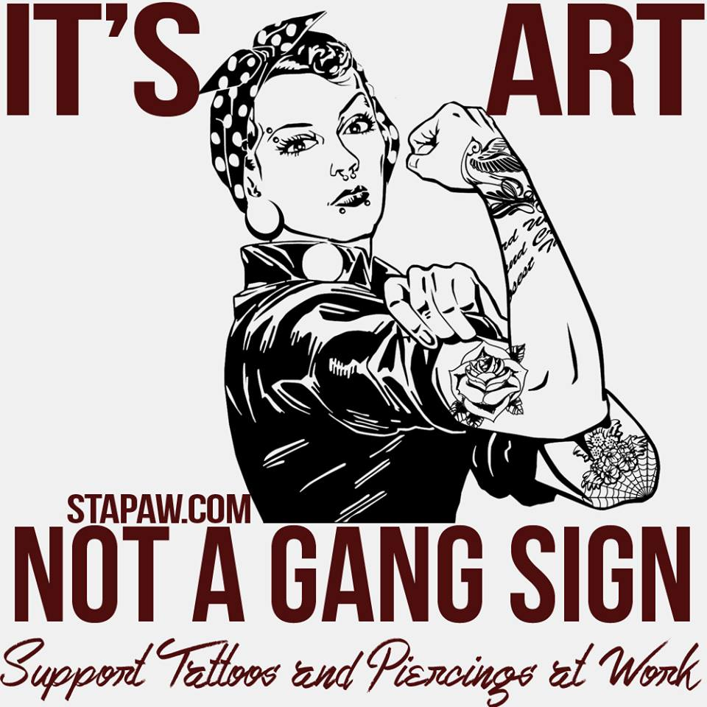
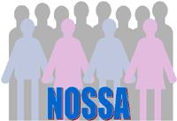

Advocacy Groups
Notes:
9to5
Work for economic security for all women- particularly women of color- for the past 45 years.
Helped a new law providing paid sick days get passes in Denver, CO.
Catalyst
Global nonprofit that works with some of the most powerful CEOs in the world to build workplaces that work for women.
Pioneer research, practical tools, and prove solutions to advance women into leadership.
AARP
AARP is fighting age discrimination by providing attorneys to protect older adults, pushing to pass legislation to fix a Supreme Court decision that made it harder to win age discrimination cases, helping change state laws, working with employers to help them understand the value of older employees, helping older employees find employers with a Job Board, and much more.
Human Rights Campaign
Advocates for LGBTQ equality and educates the public about LGBTQ issues.
HRC Foundation works to encourage the adoption of LGBTQ inclusive policies and practices.
Natural Hair Movement
Encourages women and men of African descent to keep their natural afro-textured hair and to love it!
Black Lives Matter
A global organization aiming to eradicate white supremacy and build local power to intervene in violence against the black community. They are creating immediate improvements in our lives by combating and countering acts of violence.
NAACP
Largest and most pre-eminent civil rights organization in the nation. Their mission is to secure the political, educational, social, and economic equality of rights to get rid of discrimination based on race.
STAPAW
Raises awareness about discrimination of piercings and tattoos in the workplace. They work with employers to change dress codes and hiring policies to allow piercings and tattoos, help employees who lose their job because of discrimination, and much more.
National Organization of Short Statured Adults
A united organization of short men and women from around the world and promotes the message of self-empowerment for all its members.
American Association of People with Disabilities
Increases the political power of people with disabilities. AAPD advocates for over 60 million Americans with disabilities and promotes equal opportunity, economic power, independent living, and political participation.
Obesity Care Advocacy Network
A group of organizations that have come together to change how we approach the problem of obesity. Their vision is to influence change in the US healthcare system to urge policy makers to realize that obesity is a complex and chronic disease that should be treated as such, like diabetes or heart disease.
Pride at work
Nonprofit organization that represents LGBTQ union memebers and their allies. They work towards making a labor movement that appreciates diversity, encourages openness, and ensures safety and dignity.

Slide 16
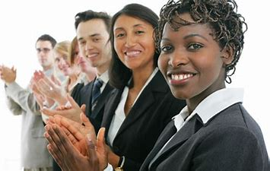
Section III
In Today’s Workplace

Slide 17
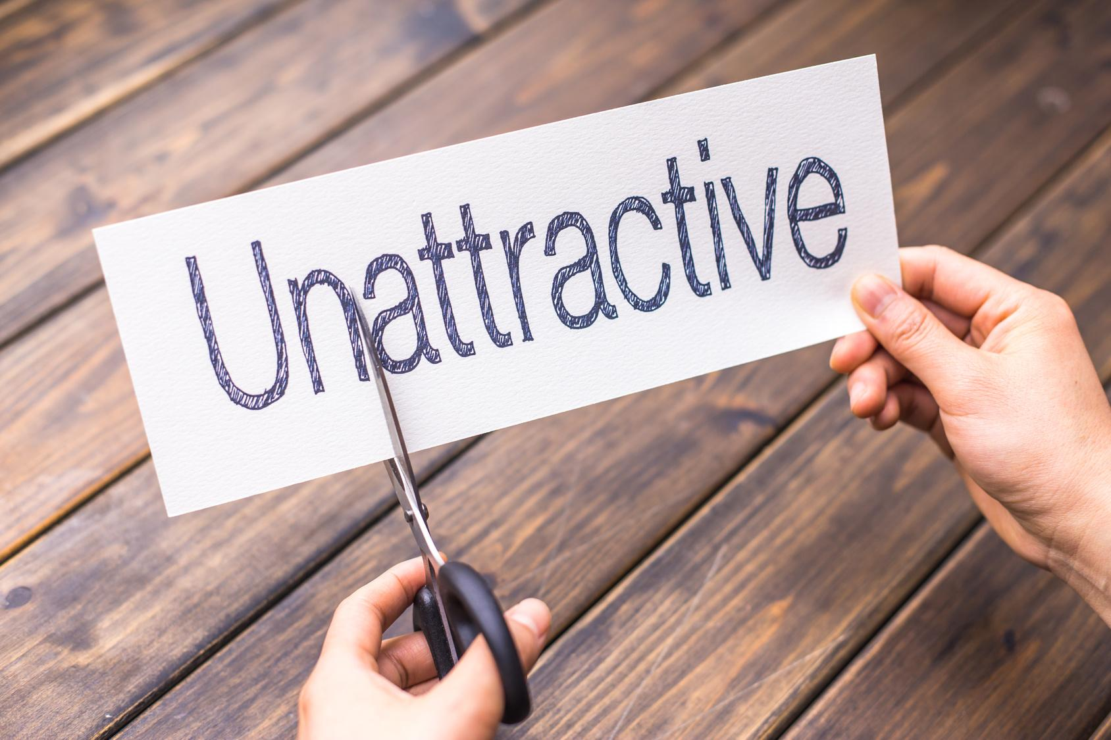
What Do Employees Desire & Need?
To be treated fairly and not to be excluded
To be offered the same opportunity as others-position and pay
Employees want to bring their authentic selves to work and feel comfortable within their own skin. With the diversity of appearance it is more difficult to hide or cover from others
Notes:
1. “ In the workplace, the way you look can be more important than the merit of your work to some supervisors, while coworkers can treat you differently if you don’t fit into their idea of professional appearances” (Schwantes, 2019)
Univia conducted a survey on looks and the impact on our professional lives:
Appearance influences client perception and company image(90%)
Appearance affects employee confidence(85%)
Appearance affects employee competency(73%)
These are very strong numbers that support how appearance is viewed in today’s workplace.
2.Kevin Hafen, CEO of Univa believes “Attractiveness bias can greatly impact career success from the hiring process down to raises and future promotions” (Schwantes 2019)
- Organizations must be more flexible on company’s core values and adapt and shape to the evolving times and at the same time promote a growth mindset or learning culture to with all dimensions of diversity within and to educate.
3. Another study noted by the Harvard Business Review involved a total of 213 employees revealed that by employees having the freedom to be their authentic self helped increase productivity, performance and success and allowed employees more time to focus on their role and responsibilities since they were spending less time and efforts hiding or covering( Wright 2016)

Slide 18
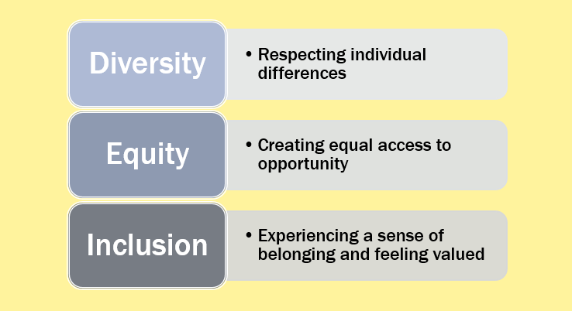
Institutional and/or Interpersonal Opportunities for Equity & Inclusion
Institutional:
Legal protections on both federal and state levels
Zero tolerance company policies for harassment around any appearance discrimination issues
Company required education though webinars and face to face to increase awareness to both management and employees
Interpersonal:
Empathetic leadership to buy into and acknowledge their people and their differences
Notes:
1. Very few laws exist to cover diversity of appearance directly. On the federal level there is no direct federal prohibition on “appearance discrimination and at times rerouted to and instead possibly tied to a status of a protected class.
Diversity of appearance touches and crosses over to multiple dimensions of diversity:
Hairstyles-might be protected under racial or religious depending on the style and situation
Obesity-can be viewed as a disability
Wearing a Hijab or Kippah can be protected as religious necessities and therefore be protected
Tattoos and body piercings once can cover during work hours, however some may have for religious reasons and be protected
Shields, Huddleston and Bolen(video)
2.Zero Tolerance Policies initiated and instituted specifically for appearance discrimination or inserted into current company policies and specified and defined.
3.Company initiatives to incorporate appearance discrimination into their learning universities and trainings to bring it to the forefront. Most employees are aware and/or trained on the more common diversity dimension issues such as race, gender and others, however, are unaware of many others and can have an unconscious bias without the proper education. Promote a growth mindset or learning culture within to encourage and learn. Companies should change adhering to compliance and instead create a culture of learning and acceptance. (Peterson and O’Conner 2019)
4. Empathetic leadership in an organization is becoming more important and necessary for companies to be able to survive their diversity and inclusion issues and initiatives.
Results that occur from an empathetic culture:
Psychological safety, so that people can speak up and challenge obstacles.
An empowering environment because people don’t feel judged.
Reduced stress levels because we’re respecting one another.
According to Bourke and Dhillon at Deloitte” six signature traits of inclusive leadership include: cognizance, curiosity, cultural intelligence, collaboration, commitment and courage. Greater empathy helps you develop these traits and become a better leader.” (Mildon 2020)

Slide 19
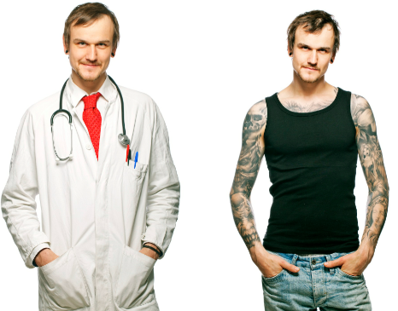
Section IV:Interesting Issues about Diversity of Appearance

Slide 20

Overview:
Appearance Discrimination and The Potential Impact on Hiring and Promotions In The Workplace
Recruitment and Discrimination of Appearance With:
Face to Face and Video Interviews
Can Have an Affect on Company Brand
Social Media Photos
Lack of Career Growth due to Discrimination of Appearance:
Race
Gender
Age
Religion
All Others...
Notes:
Recruitment:
--Face to Face Interviews-Must preset job criteria and measure against these accordingly. Organizations have both a legal duty and an ethical duty to hire the most qualified candidate for a position, regardless of appearance.
In most cases, the only ways to recover on a claim of attractiveness is for the discrimination to “fit” under another protected characteristic. (Wexler p.1) Candidates can cover tattoos, body piercings and hair styles during an interview to hide behind who they really are. In one case Kerion Washington who did not cover on his hair style was denied a position last year at a Six Flags in Texas due to his hair length and locks and was asked to return once he cut his hair. He refused and his mother posted the occurrence on social media and he in the end secured a large modeling contract.(Sarder)
--Video interviews-Must preset job criteria and measure against these accordingly. Carik R Miaskoff, Assistant Legal Counsel for the EEOC had issued a letter stating that virtual or video interviews are not inherently discriminatory. Company’ s must structure interviews to be consistent.
--Company Brand-Several lawsuits have gone to court with companies’ hiring for image matches and branding. Abercrombie & Fitch was a prime example with their shirtless very fit young males used in ads and as in-store models. After several lawsuits that have now changed their recruitment approach with seeking employees that will give the best customer service and shopping experience.
--Social Media Photos-examples such as LinkedIn and Facebook can depict just by the appearance and that “Employers need to consider ADA aspects, such as a website, showing dress, appearance or lifestyle based upon religion” say Lester Rosen, founder and CEO Employment Screening Resources. Companies must establish consistent and standard practices to show decisions are made on an objective basis using metrics.(Mancini p.1)
Discrimination rules also apply when just sourcing prospective candidates.
Promotion and Career Growth:
Professional success doesn’t entirely depend on your work ethic and performance according the Business Insider. Career Builder surveyed on this subject and the results showed that Managers seriously consider professional appearance when making a decision to promote to a higher position. (Smith p. 1)

Slide 21
CareerBuilder Survey 2016
Some Interesting Facts:
CareerBuilder Survey 2016
More than 2,000 human resource managers across the US participated in the survey and cited these nine (superficial) factors as things that would dissuade them from promoting an employee:
44% were less likely to promote an employee who wore provocative clothing to work.
43% were less likely to promote an employee who wore wrinkled clothes.
32% were less likely to promote an employee with piercings other than traditional ear piercings.
27% were less likely to promote an employee who frequently wore clothing that was too casual for the workplace.
27% were less likely to promote an employee with visible tattoos.
25% were less likely to promote an employee with an unprofessional hairstyle.
24% were less likely to promote an employee with constant bad breath.
21% were less likely to promote an employee who wore too much perfume or cologne.
15% were less likely to promote an employee who wore too much makeup.
Source: 9 Appearance Mistakes That Could be Holding You Back At Work, Business Insider, October 11,2016

Slide 22
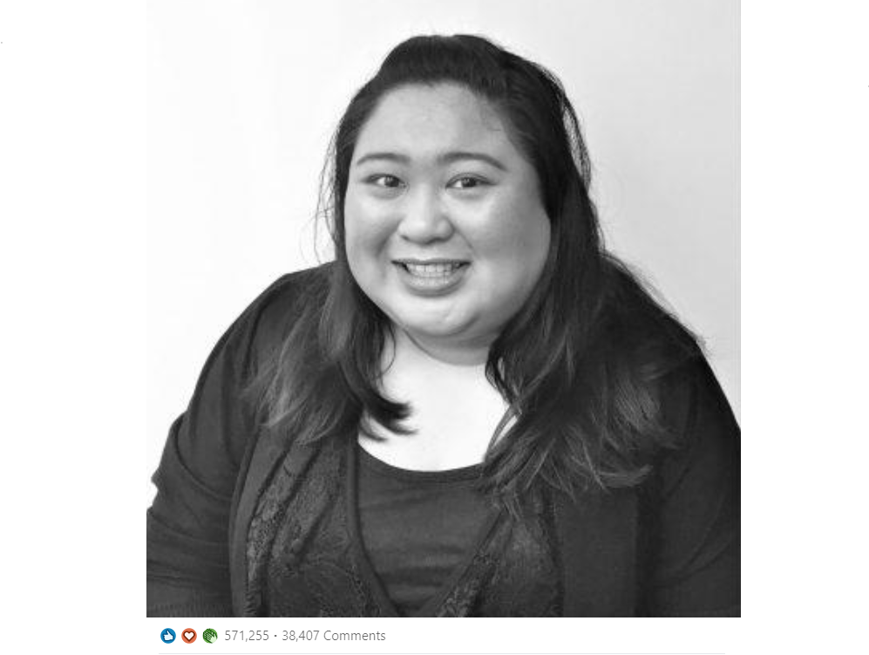
Jessica’s Story Posted 2 Weeks Ago on LinkedIN
https://www.linkedin.com/posts/jessica-joan-richards-481a1181_beautywithin-bodyshaming-badmanagers-activity-6684117911885500416-vqak

Slide 23
Thoughts in Relation to the Topic:
Candidates and employees deserve a fair and equal opportunity. It is the duty of organizations to educate its Hiring Managers on implicit and unconscious bias and not just one time! Continuous education is needed and best are in person sessions. It's a stronger approach that resonates better and has a more lasting affect.
Appearance based discrimination in the workplace is more complex than most of the other dimensions of diversity and thus may be more difficult to approach
As we evolve we anticipate more appearance based focuses to form and then with time and efforts to become more acceptable- ex. Body piercings, other than earrings, barely existed 20 years ago and now have become the trend.
Many companies still hire for appealing and attractive looks for front line positions and other client focused roles
*All of the above are shared thoughts from both team members
Notes:
o It is unimaginable that in today’s world there are still some dimensions of diversity under the appearance topic that are not protected such as height and weight, tattoos and body piercings. I believe that even if they became protected that we still would have unconscious bias within organizations, and discrimination could still exist. It is imperative that we improve our ways at looking at candidates for their qualifications and previous experience they can bring to the table and not for the way you look and the stereotypes that come along with it. I still see a lot of hiring based on how similar they are to a Hiring Manager or if they are a “cultural fit”. How is a cultural fit defined today? Organizations have been better with educating their Management on better hiring practices; however, we have a long way to go!
o With appearance discrimination and hiring practices in the workplace, it encompasses a wide array of subjects and it intertwined and/or related to other various dimensions of diversity. In some ways it is more complex and in other ways one is already aware.
o It will be interesting to see what other themes will fall under the diversity of appearance in the future. For example, 30 years ago body piercings primarily existed mostly on ears. Today the landscaped has completely changed to many different types of body piercings that did not exist years ago. With each new appearance theme that comes to light, discrimination will be more in the beginning phases when society is not used to seeing it in the workplace.
o I believe that the beauty bias still exists in society overall and affects organizations especially when seeking to fill customer facing roles. We may be overlooking some extraordinary talent out there that do not have the same chance/opportunity that a more attractive candidate may have. An attractive image can be an advantage in an organization, but true qualifications and talent should be at the forefront of a hiring decision.

Slide 24
Bibliography

Slide 25
Resources Used To Develop The Presentation
Flake, D. (2015). Image is Everything. University of Pennsylvania LAw Review. Retrieved July 21, 2020
Gillibrand, K., Reilly, C., Barbarin, I., Siegel, M., Daniari, S., & Yurcaba, J. (2017, April 17). Black Hair Discrimination Is Real-But Is It Against the Law? #ABLC
Gomez, Evangeline (2012) Should Businesses Worry About Appearance-Based Discrimination in the Workplace? Forbes.
Griffin, Chante (2019, july 3). How natural black hair at work became a civil rights issue. JSTOR Daily.
Hurley, L. (2015, June 01). U.S. top court backs Muslim woman denied job over head scarf. Retrieved July 21, 2020, from https://www.reuters.com/article/us-usa-court-scarf/u-s-top-court-backs-muslim-woman-denied-job-over-head-scarf-idUSKBN0OH2NW20150601
Johnson, Stefanie. K. et. al (2010) Physical Attractiveness Biases in Ratings of Employment Suittability. Journal of Social Psychology.
Mancini, Mia (2017) Lessons Learned in Social Media, Recruiting and Discrimination. Workforce.com.
Martin, A. (2017, August 16). Weight Discrimination Is Legal in 49 States.
Mildon, Toby (2020) Diversity and includsion:what can an empathetic culture bring to business? HR Zone.
Morabito, Charlotte (2020) Studies show weight discrimination permeates the US Workplace-but it’s legal in 49 states. CNBC.
Ortiz, A. (2020, May 12). Aimee Stephens, Plaintiff in Transgender Case, Dies at 59.
Padilla, M. (2019, December 20). New Jersey Is Third State to Ban Discrimination Based on Hair.
Pasha-Zaidi, Nausheen. (2015). Judging by Appearances. Journal of International Women’s Studies, Vol. 16, No. 2

Slide 26
Resources Used To Develop The Presentation
Peterson and O’Connor (2019) Time to Rethink Bringing Your Whole Self to Work? Forbes.
Roepe, Lisa Rabasca (2017) How your Appearance Impacts Hiring Decisions. Forbes.
Sarder, Sarah (2019) Teen who hair cost him a job at Six Flags Over Texas turns heads at modeling agency. The Dallas Morning News.
Smith, Jacquelyn (2016) 9 appearance mistakes that could be holding you back at work. business Insider
Schwantes, Marcel (2019) New Research Reveals Why “Appearance Discrimination” Is Making Workplaces Even More Toxic. Inc.
Sheets, Scott (2014) Workplace Dress and Appearance Codes. You Tube Video.
Toledano, Enbar. (2013). The Looking-Glass Ceiling: Appearance-Based Discrimination in the Workplace. Cardozo Journal of Law & Gender, Vol. 19:683.
Wexler, Bre (2017) Appearance-Based Employment Discrimination: A Proxy for Gender Discrimination? Saint Louis University Law Journal.
Wong, Kristin (2016) How Employers Judge Appearance When Considering Someone for a Promotion. Lifehacker
Wright, Abbie (2016) Why The Mohawk Is Good For Business. Training Journal.
(2010). Civil RIghts/Employment Law- States Carry Weight of Employment Discrimination Protection. New England Law Review. Vol 32:173.
(2009) Height Discrimination in Employment. Utah Law Review.

Slide 27

Recommended Discussion Points

Slide 28
Questions for Our Learning Community
How does your company feel about tattoos and body piercings in the workplace? Would you be willing to cover your tattoo or body piercing if your Manager requested after you already have tenure with the company?
Which dimension of appearance do you feel is the most difficult to address with an employer and why?
What are your thoughts on employers and Social Media profiling during the recruitment process? Do you think it exists?
In some states, employers may say that “natural” hair may look unprofessional, causing individuals to spend money on chemical relaxers or excessive heat. Do you think a company should compensate these employees for the money they spend on their hair? Why or why not?

